Slide 1
Machine Learning

Slide 2
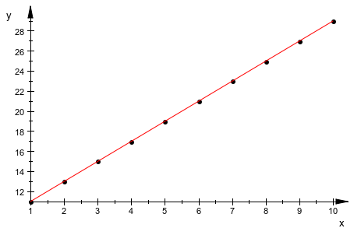
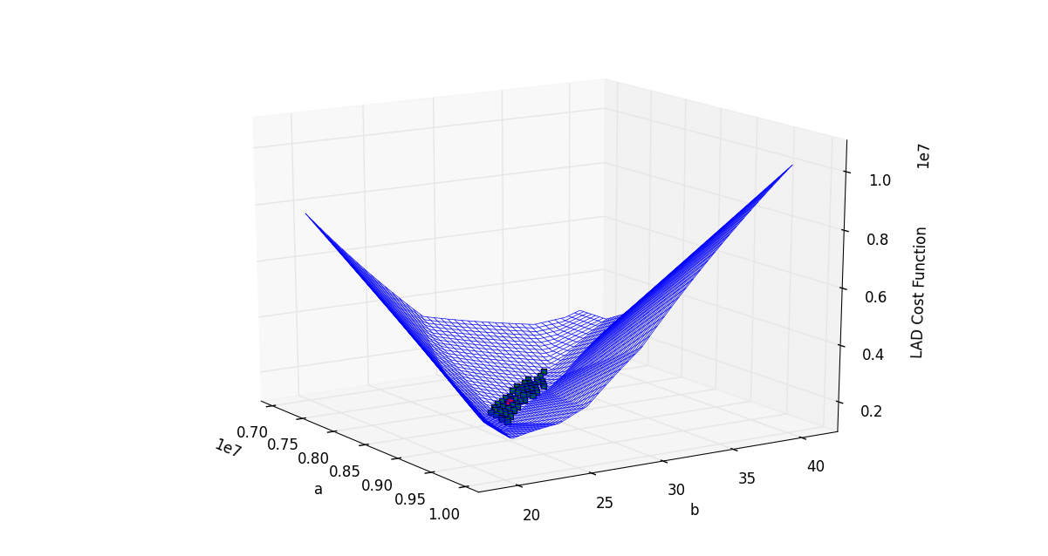
Univariate & Multi features
Dealing with one features for X
Dealing with Multi features for X

Slide 3
Multiple Features
All of previous talk is about univariate linear regression which means is just we need to map X to Y and both of them is just one variable.
Which just:
X was in R¹
h(x)= θ₀ + θ₁x
Now X in R^{n+1} what is mean ..!
First should notice the difference between small and capital.
x₁ | x₂ | x₃ | y
1 | 3 | 4 | 3
5 | 2 | 1 | 5
4 | 4 | 3 | 4
8 | 9 | 5 | 8

Slide 4
New Notations
X^{i}_{j} = value of feature j in the i-th training example
X¹₁ = 1 The first feature of first training example.
X⁴₃ = 5 third feature of fourth training example.
m = 4 number of training example in our dataset
n = 3 number of features for each training example.
x₁ | x₂ | x₃ | y
1 ---> first feature of first training example | 3 | 4 | 3
5 | 2 | 1 | 5
4 | 4 | 3 | 4
8 | 9 | 5 → third feature of fourth training example | 8

Slide 5
New Equation
hθ(x)=θ₀+θ₁x₁+θ₂x₂+⋯+θ_{n}x_{n}
In order to develop intuition about this function, we can think about θ₀​ as the basic price of a house, θ₁​ as the price per square meter, etc.
Now it's seems complicated to dealing with all of these parameters and features.
So because of that we have discussed some of Linear Algebra previous session.
x₁ | x₂ | x₃ | y
1 | 3 | 4 | 3
5 | 2 | 1 | 5
4 | 4 | 3 | 4
8 | 9 | 5 | 8

Slide 6
Vectorization
“So now the price of home is not just affected by size of home but another feature is coming in like number of bedrooms, number of floor and others”
Its now depends on multiple features or what is called Linear Regression with Multiple Variables
Θ = [ θ₀ θ₁ θ₂⋯θ_{n} ]
Assume X₀ = 1, which will not effect and help us doing matrix operations.
X = [ X₀ X₁ X₂ ….. X_{n} ]
Hence making the two vectors 'θ’ and x match each other element-wise (that is, have the same number of elements: n+1).

Slide 7
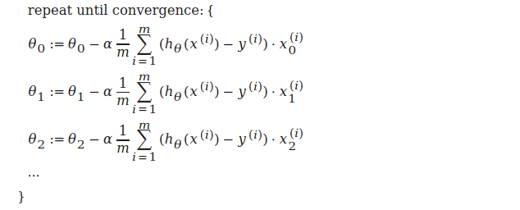
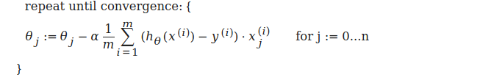
Gradient Descent For Multiple Variables
The same equation but is not one feature X₀ and X₁, but it's now in n feature and also simultaneously updated.

Slide 8
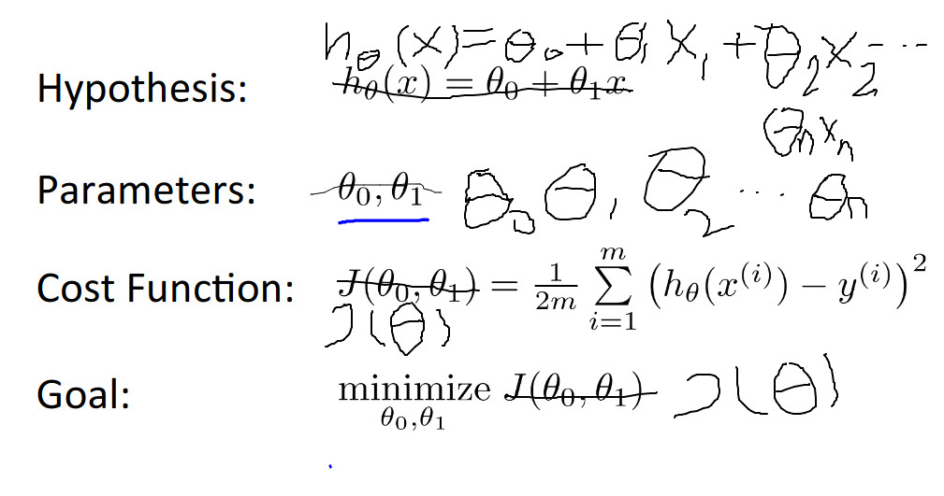
New updates with multi features

Slide 9
Feature Scaling & Normalization
We can speed up gradient descent by having each of our input values in the same range. This is because θ will descend quickly on small ranges and slowly on large ranges.
Also Scaling help us from NAN values.
−1 ≤ x_{i} ≤ 1
0 ≤ x_{i} ≤ 1
These aren't exact requirements, we just trying to speed up the learning algorithm. The goal is to get all input variables into one of these ranges.
Two techniques to help with this are feature scaling and mean normalization

Slide 10

Feature Scaling & Normalization Formula
Get means for each feature
Subtract each example from the mean
Divide by the S_{i}
Where μ₁ is the average of all the values for feature (i) and S_{i} is the range of values (max - min), or s​ is the standard deviation.

Slide 11
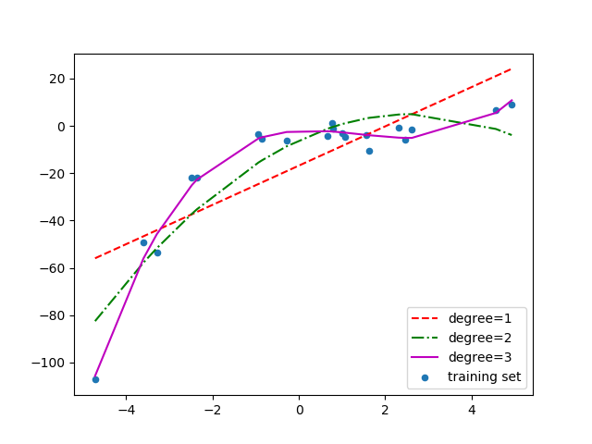
Polynomial regression

Slide 12
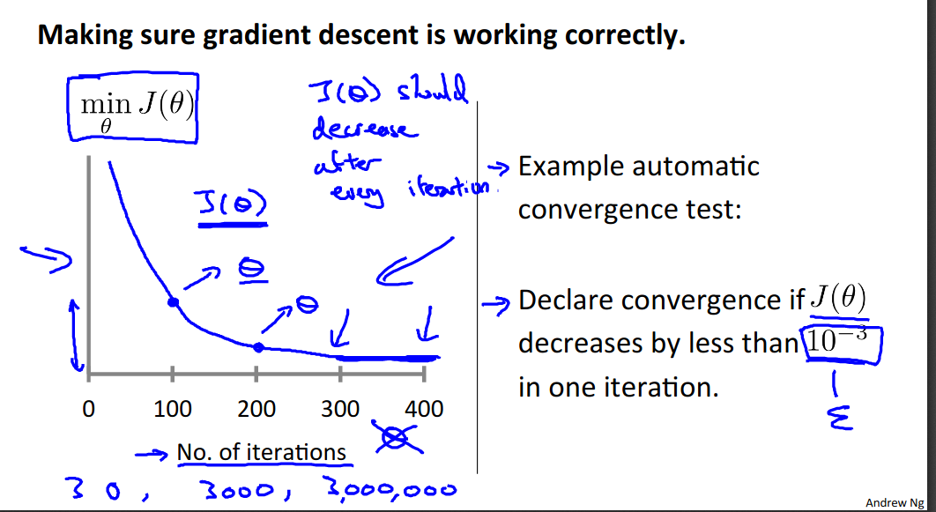
Number of iterations
Debugging: How to make sure gradient descent is working correctly.
How to choose learning rate Alpha.

Slide 13

Normal Equation
We try all of these iteration in the way of tune the parameters that minimize the cost function to Global Minimum but Normal Equation get these parameters directly in one step.
There is no need to do feature scaling with the normal equation.
No need to choose alpha
No need to iterate
But O(n³) because of transpose X is so consumed.
Slow if n is very large because of to power 3.
when n exceeds 10,000 it might be a good time to go from a normal solution to an iterative process.

Slide 14
Linear Regression with Unvirate & Multi Variables Example
Unvirate & Multi Variables Example

Slide 15
Python install
Pip- windows
Pip-ubuntu
Conda-windows
anaconda-linux

